Slide 1
Chapter 3
Arithmetic for Computers
Notes:
Morgan Kaufmann Publishers
Chapter 3 — Arithmetic for Computers

Slide 2
Arithmetic for Computers
§3.1 Introduction
Operations on integers
  Addition and subtraction
  Multiplication and division
  Dealing with overflow
Floating-point real numbers
  Representation and operations
Chapter 3 — Arithmetic for Computers — <number>
Notes:
Morgan Kaufmann Publishers
Chapter 3 — Arithmetic for Computers

Slide 3
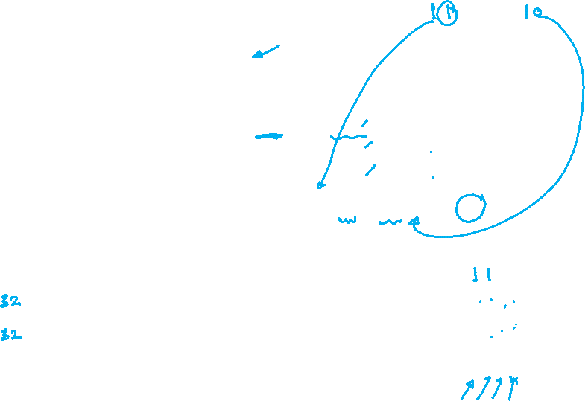

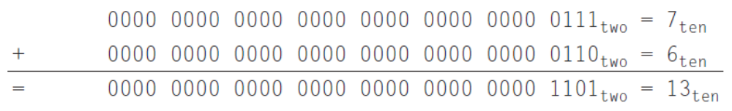
Integer Addition
Example: 7 + 6
§3.2 Addition and Subtraction
Chapter 3 — Arithmetic for Computers — <number>
Notes:
Morgan Kaufmann Publishers
Chapter 3 — Arithmetic for Computers

Slide 4
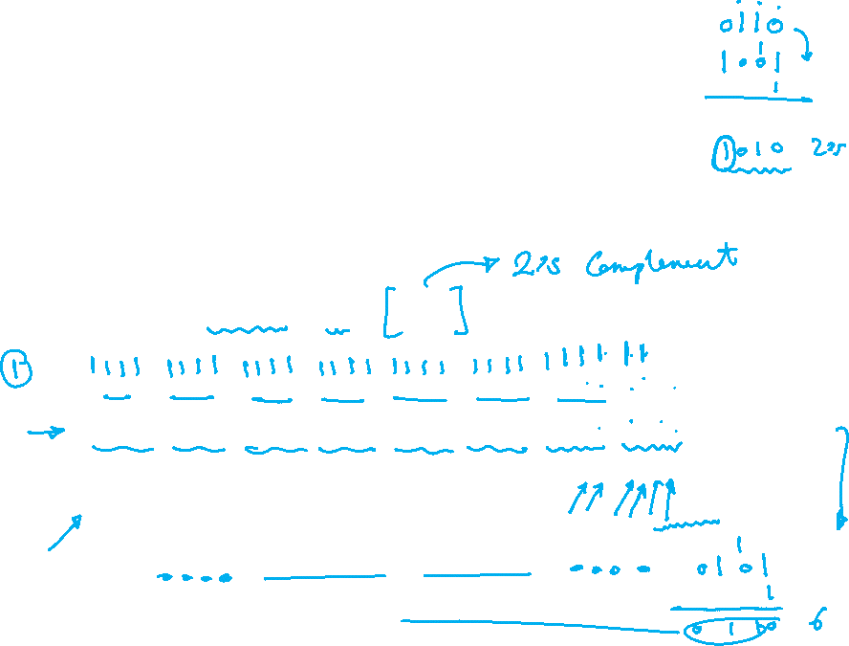
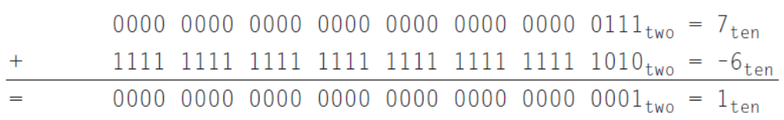
Integer Subtraction
It is an Addition operation → Add negation of second operand then add
Negating operand means expressing it with its 2’s complement
Example: 7 – 6 = 7 + (–6)
Chapter 3 — Arithmetic for Computers — <number>
Notes:
Morgan Kaufmann Publishers
Chapter 3 — Arithmetic for Computers

Slide 5
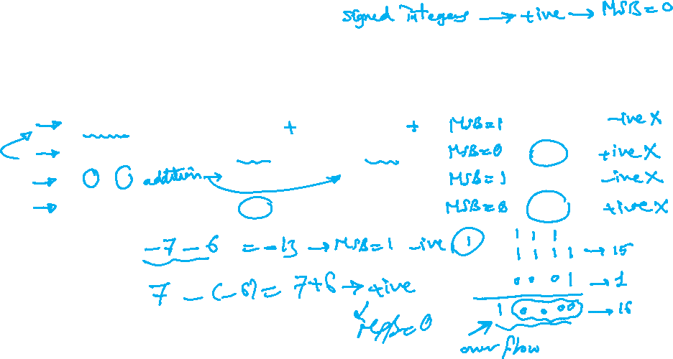
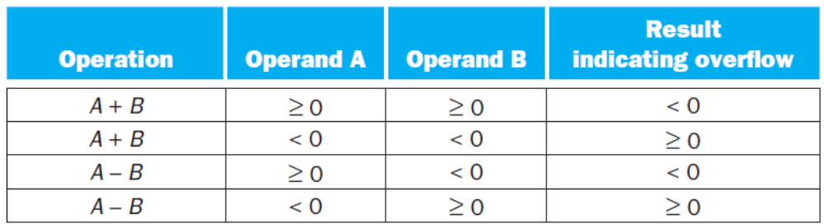
Summary of Overflow Conditions
All conditions are summarized in the following table
Chapter 3 — Arithmetic for Computers — <number>
Notes:
Morgan Kaufmann Publishers
Chapter 3 — Arithmetic for Computers

Slide 6
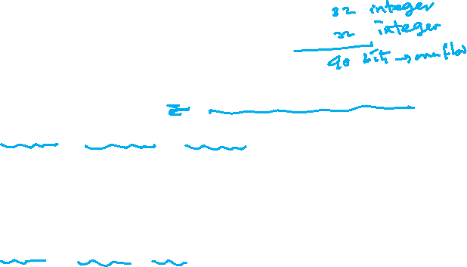
Dealing with Overflow
Some languages (e.g., C) ignore overflow
  Use MIPS addu, addui, subu instructions
Other languages (e.g., Ada, Fortran) require raising an exception
  Use MIPS add, addi, sub instructions
  On overflow, invoke exception handler
    Save PC in exception program counter (EPC) register
    Jump to predefined handler address
    mfc0 (move from coprocessor reg) instruction can retrieve EPC value, to return after corrective action
Chapter 3 — Arithmetic for Computers — <number>
Notes:
Morgan Kaufmann Publishers
Chapter 3 — Arithmetic for Computers

